Slide 1



Leveraging Student-Teacher learning framework for semi-supervised visual anomaly detection and segmentation Alessandro Polidori
Academic year: 2021-2022
Advisor: Prof. Giacomo Boracchi

Slide 2
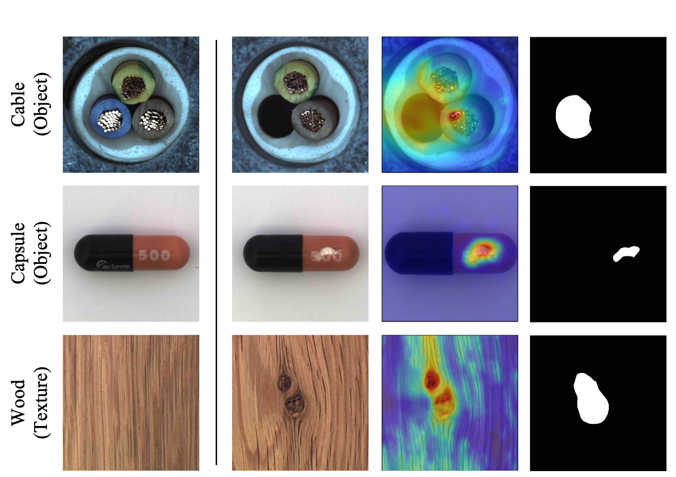
Visual Anomaly Detection and Segmentation
Normal
Anomalous
Score Map
Mask
Our model has to:
predict if a test image is anomalous
provide a mask of the anomalous regions
Image: Anomaly detection examples taken from the MVTec AD dataset

Slide 3
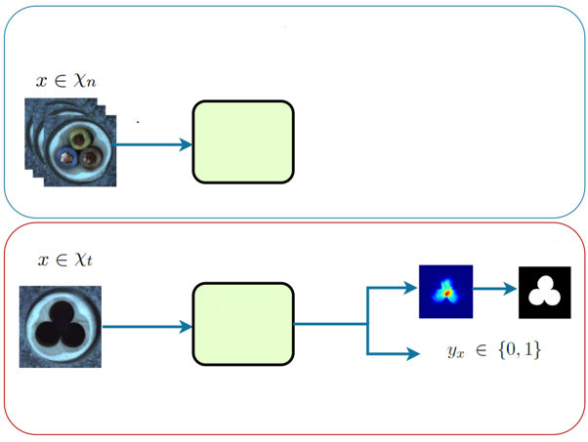
Semi-supervised Visual Anomaly Detection and Segmentation
Training phase
Model
Training the model using normal images (anomaly-free) only
Test phase
Mask
Model

Slide 4
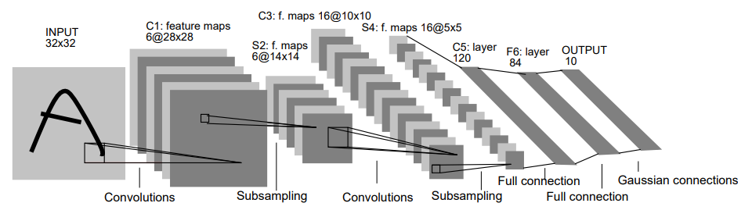
State of the art
Crucial to extract representative features from input images
deep convolutional neural networks are very good features extractors
Image: Yann Lecun et. Al, Object Recognition with Gradient-Based Learning

Slide 5
State of the art
Crucial to extract representative features from input images
deep convolutional neural networks are very good features extractors
State of the art is dominated by approaches based on CNNs
Image: Yann Lecun et. Al, Object Recognition with Gradient-Based Learning

Slide 6
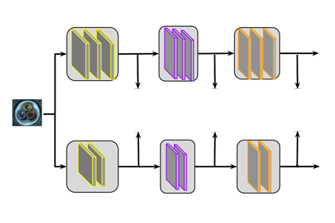
Student-Teacher learning framework
Initially conceived as a compression technique for neural networks
Weak Student model is trained to match a Strong pretrained Teacher’s predictions or intermediate representations
Teacher Network
Latent Space
Teacher
Loss
Loss
Loss
Student
Student Network
Papers: Geoffrey Hinton et. Al, Distilling the knowledge in a Neural Network, 2014 A. Romero et Al. , Fitnets: Hints for thin deep nets, 2014

Slide 7
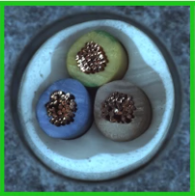
Student-Teacher learning framework
How can we exploit this framework for visual anomaly detection?
Student is trained on normal images of target dataset to behave as the Teacher
Latent Space
Teacher
Student
Good

Slide 8
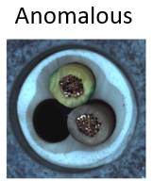
Student-Teacher learning framework
How can we exploit this framework for visual anomaly detection?
Discrepancy between Student and Teacher can be used as an anomaly score at test time
Teacher Network
Latent Space
Teacher
Larger distance
Bad
Compare
Compare
Compare
Student
Student Network

Slide 9
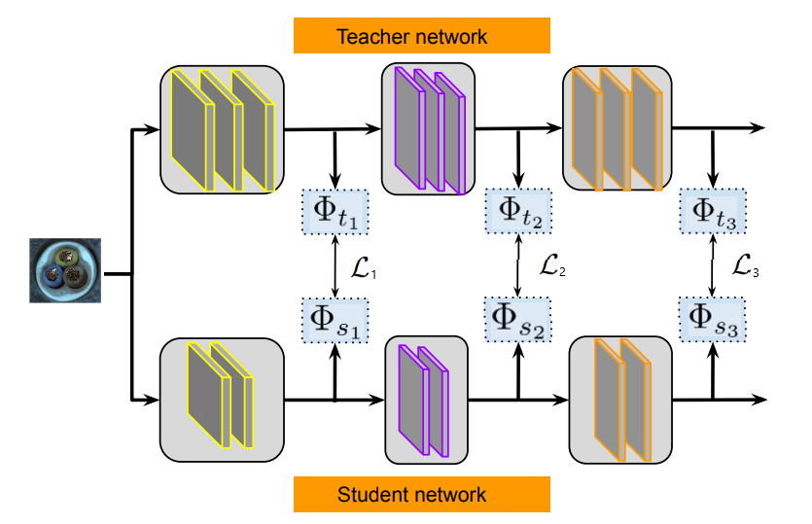

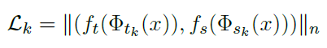
Background: feature-based Knowledge Distillation
Transferring knowledge from Teacher to Student
imposing a distance/similarity function between intermediate feature maps as loss function
layer k
Paper: Romero et Al, Fitnets: Hints for thin deep nets, 2014

Slide 10
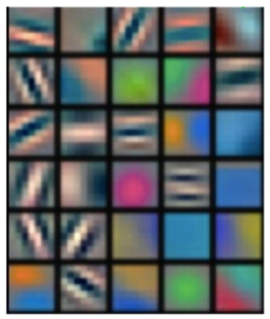
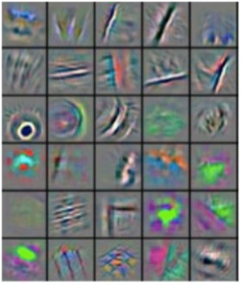
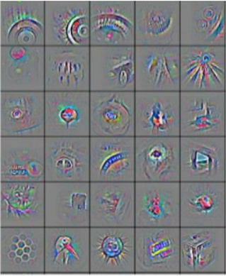
Background: feature-based Knowledge Distillation
Transferring knowledge from multiple intermediate feature maps
It allows to detect anomalies at different scales
These inputs produce feature maps with the highest activation
Paper: Romero et Al, Fitnets: Hints for thin deep nets, 2014

Slide 11
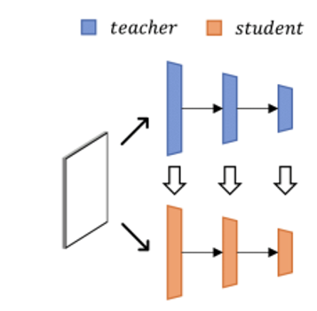
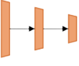
Background: Uninformed Students
descriptor
vectors
Teacher
Fixed patch-size
Ensemble of Students
(r,c) patch
Student
µ^{S1}(r,c)
S1
µ^{S2}(r,c)
S2
µ^{S3}(r,c)
S3
Paper: Bergmann et. Al, Uninformed Students: Student-Teacher Anomaly Detection with Discriminative Latent Embeddings, 2020

Slide 12
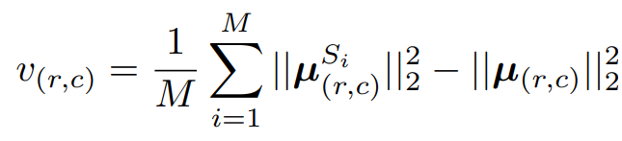
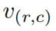
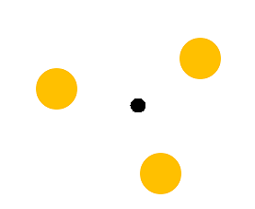
Background: Uninformed Students
descriptor
vectors
Teacher
Fixed patch-size
Ensemble of Students
Predictive uncertainty v(r,c) added to anomaly score:
(r,c) patch
Student
µ^{S1}(r,c)
S1
µ^{S2}(r,c)
S2
µ^{S3}(r,c)
S3
Students’ average
Paper: Bergmann et. Al, Uninformed Students: Student-Teacher Anomaly Detection with Discriminative Latent Embeddings, 2020

Slide 13
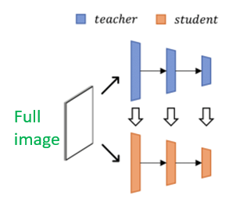
Background: STFPM (Student Teacher Feature Pyramid Matching)
Feeding entire input all in once
Paper: Wang et. Al, Student-Teacher Feature Pyramid Matching for Anomaly Detection, 2021

Slide 14
Background: STFPM (Student Teacher Feature Pyramid Matching)
Feeding entire input all in once
Feature based distillation from multiple layers
Paper: Wang et. Al, Student-Teacher Feature Pyramid Matching for Anomaly Detection, 2021

Slide 15

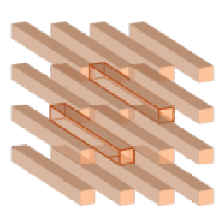
Background: STFPM (Student Teacher Feature Pyramid Matching)
Feeding entire input all in once
Feature based distillation from multiple layers
For each k-th layer group, we consider normalized Feature Vectors Φ(x)i,j in feature maps’ (i,j) positions
j
i
Feature vectors
Paper: Wang et. Al, Student-Teacher Feature Pyramid Matching for Anomaly Detection, 2021

Slide 16
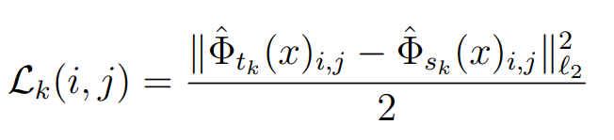
Background: STFPM (Student Teacher Feature Pyramid Matching)
Feeding entire input all in once
Feature based distillation from multiple layers
For each k-th layer group, we consider normalized Feature Vectors Φ(x)i,j in feature maps’ (i,j) positions
Cosine similarity:
j
i
as loss and anomaly score
Feature vectors
Paper: Wang et. Al, Student-Teacher Feature Pyramid Matching for Anomaly Detection, 2021

Slide 17
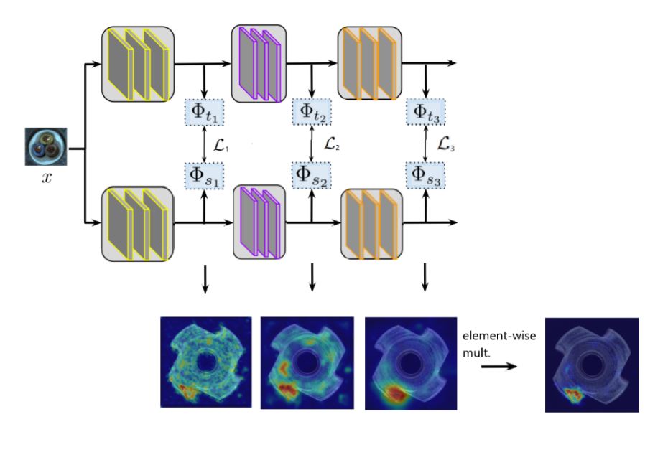
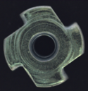

Background: Anomaly score maps
Anomaly score maps

Slide 18
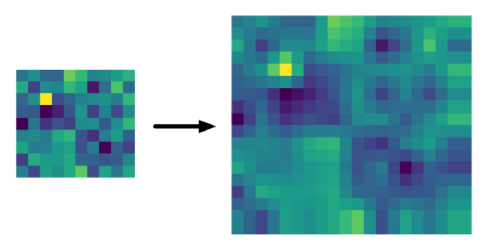
Background: Anomaly score maps
We need to upscale intermediate anomaly maps
input dims: (h,w)
Bilinear interpolation
Anomaly score maps

Slide 19
Proposed methods: Feature Vectors Variance
Starting from STFPM general scheme:

Slide 20
Proposed methods: Feature Vectors Variance
S1
S2
Starting from STFPM general scheme:
An ensemble of identical Students is trained to match Teacher’s Feature Vectors on nominal images
S3

Slide 21
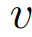

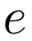
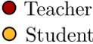
Proposed methods: Feature Vectors Variance
S1
S2
Starting from STFPM general scheme:
An ensemble of identical Students is trained to match Teacher’s Feature Vectors on nominal images
We design an intuitive score v to evaluate the ensemble’s disagreement/ uncertainty
When we compute anomaly score, we add to the standard regression error between Students’ average and Teacher
S3

Slide 22
Proposed methods: Feature Vectors Variance
To compute …

Slide 23
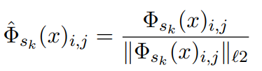
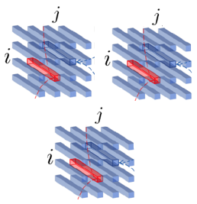
Proposed methods: Feature Vectors Variance
Students’ k-th layer’s feature maps
Given a layer k, we first ℓ2- normalize the Students’ Feature Vectors:
Student 1
Student 2
Student 3

Slide 24
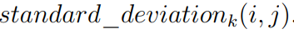

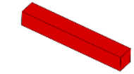
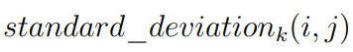
Proposed methods: Feature Vectors Variance
Students’ k-th layer’s feature maps
Given a layer k, we first ℓ2- normalize the Students’ Feature Vectors:
For each (i,j) position we obtain cjjjjjjjjjjjjjjjjjjjjjjjjjjjjjjjjjjjjjjjjjjjjjjjjjjjjjjjj . This vector contains in each element the standard deviation between the Students’ Feature Vectors’ values.
Student 1
Student 2
Student 3

Slide 25
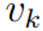
Proposed methods: Feature Vectors Variance
Students’ k-th layer’s feature maps
Given a layer k, we first ℓ2- normalize the Students’ Feature Vectors:
For each (i,j) position we obtain cjjjjjjjjjjjjjjjjjjjjjjjjjjjjjjjjjjjjjjjjjjjjjjjjjjjjjjjj . This vector contains in each element the standard deviation between the Students’ Feature Vectors’ values.
For each k-th layer, the scalar uncertainty measure vk in (i,j) is then:
Student 1
Student 2
Student 3

Slide 26
Proposed methods: Simple Student
Starting from STFPM general scheme:

Slide 27
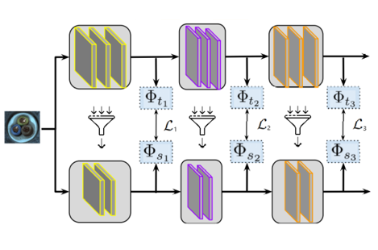
Proposed methods: Simple Student
Starting from STFPM general scheme:
Teacher Network
Here the Student has a simpler architecture with respect to Teacher
Simple Student Network

Slide 28
Proposed methods: Simple Student
Starting from STFPM general scheme:
Teacher Network
Here the Student has a simpler architecture with respect to Teacher
Now the Student needs to learn how to compress nominal features as well
Worse compression of anomalous features at test time entails a greater discrepancy
Simple Student Network

Slide 29
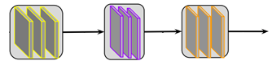
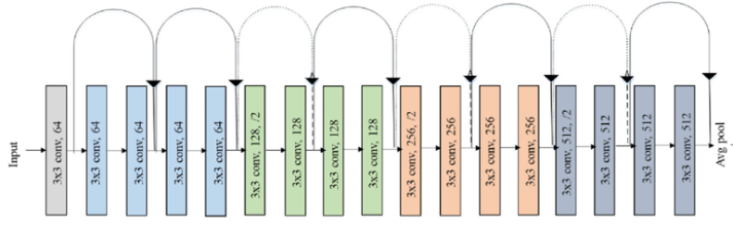
Proposed methods: Simple Student
We reduced the number of filters inside convolutional layers where possible
Constraints:
Feature based distillation
Teacher
Teacher
Student
ResNet18 Architecture

Slide 30
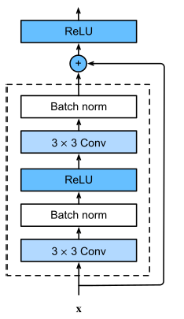
Proposed methods: Simple Student
We reduced the number of filters inside convolutional layers where possible
Constraints:
Feature based distillation
Residual connections
Teacher
Teacher
Student
ResNet18 Architecture

Slide 31
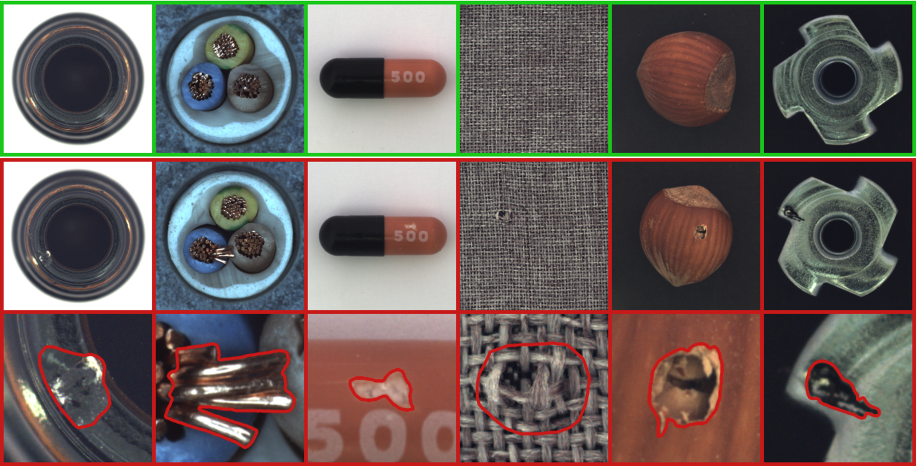

Experiments: Datasets
Over 5000 high-resolution images
Fifteen different object and texture categories
Image: https://www.mvtec.com/company/research/datasets/mvtec-ad

Slide 32
Experiments: Datasets
For each category:
A set of defect-free samples and
Various defective sets (with ground-truth masks)
Image: https://www.mvtec.com/company/research/datasets/mvtec-ad

Slide 33
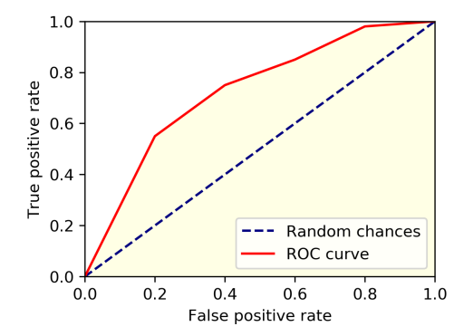
Experiments: Metrics
Image-AUROC

Slide 34
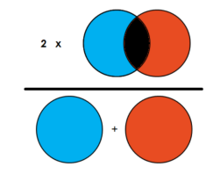
Experiments: Metrics
Image-AUROC Dice Score

Slide 35
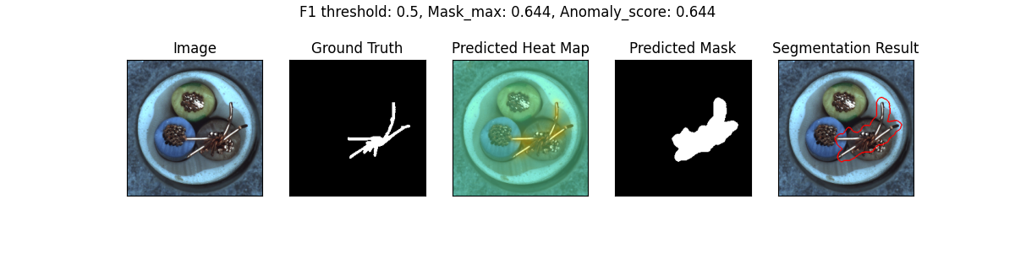
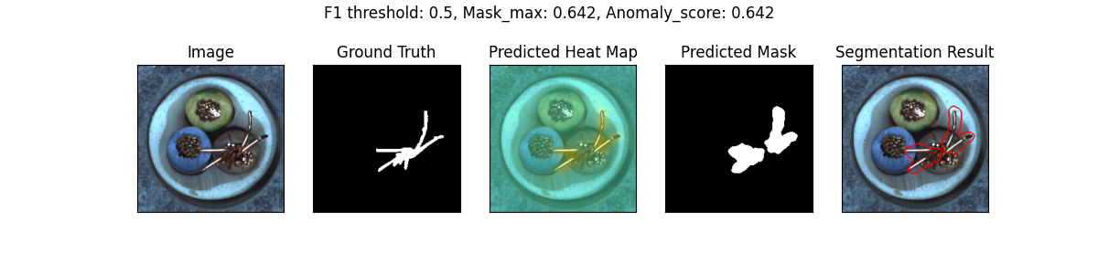
Feature Vector Variance output example
Simple Student output example

Slide 36
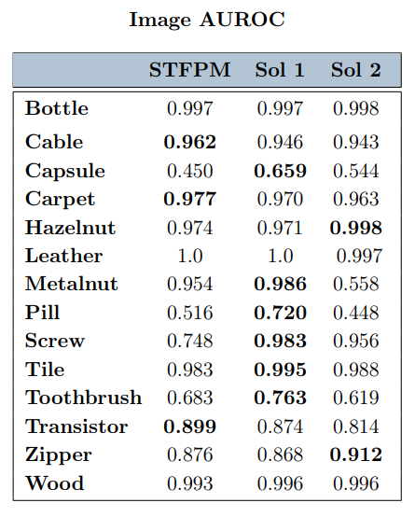
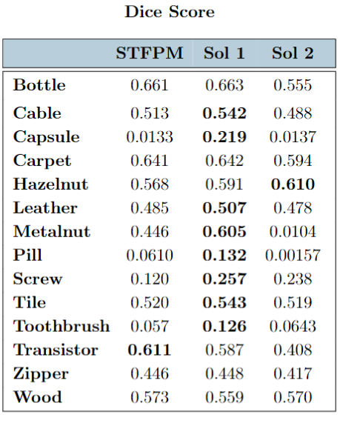
Results
bold : best
: better than
STFPM

Slide 37

Results
bold : best
: better than
STFPM

Slide 38

Results
bold : best
: better than
STFPM

Slide 39
Conclusions
Feature Vectors Variance
When it doesn’t improve, it maintains baseline’s performances
Valid option if it’s possible to sacrifice more computing resources
Confirmed by the fact that STFPM with WideResnet_50 does not improve the results significantly
Simple Student
Promising results confirm that simplifying the Student can improve AD performance
But performs notably worse than STFPM in some categories
Likely caused by an excessive simplification of the Student’s architecture

